Slide 1

ACTIVE DEVCES
TRANSISTOR
Two main roles:
Amplifier circuit
Switching circuit
Two types:
BJT
FET
Analysis:
DC (Biasing)
AC (Voltage and current gains)

Slide 2
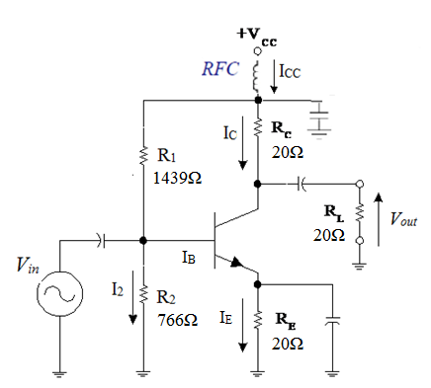
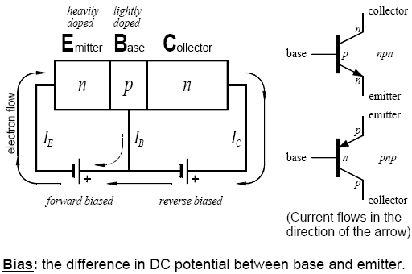
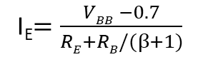
REVIEW: BJT - DC and AC ANALYSIS
V_{CC}=20V
I_{E}$=\frac{VBB −0.7}{RE+RB/(β+1)}$
V_{BB}=V_{CC}.R₂/(R₁+R₂)
2
R_{B}=R₂//R₁

Slide 3
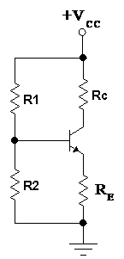
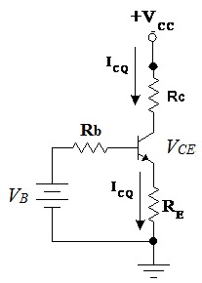
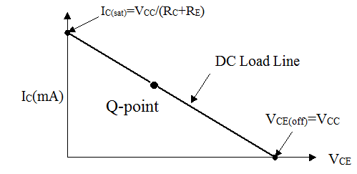
DC analysis
A transistor amplifier is biased so that the Q-Point is located on the DC Loadline.
DC load line
=>I_{E}=I_{C}+I_{B}= I_{B}(1+β) ≈ I_{B}.β=I_{C}. Since β>>1
Equation of DC load line

Slide 4
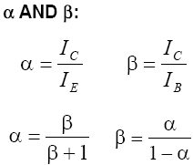
α is constant for a particular transistor. It's value is less than but close to 1, normally 0.98-0.9995. a is the gain of a
Common-Base amplifier.
β is constant for a particular transistor, typically in the range of 100 to 200 but may be 50- 2000. Since the value of β
may vary significantly among transistors of the same type, a
β-tolerant circuit design is desirable. β is the Common-Emitter current gain.
4

Slide 5
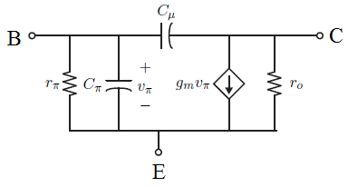
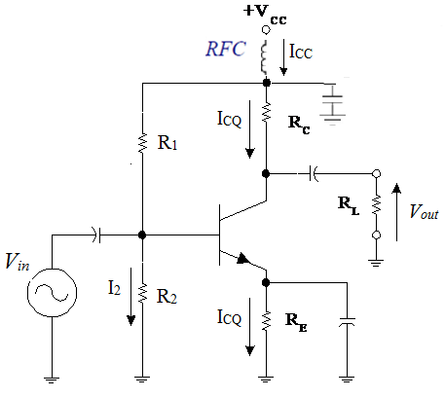
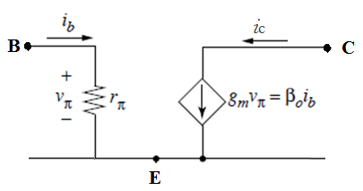
REVIEW: BJT - AC ANALYSIS
AC signal model of BJT
Supposing that Cμ, Cπ
are negligible
DC block: Zc=1/ωC is large
=> Zc =0(Ω) at AC mode.

Slide 6
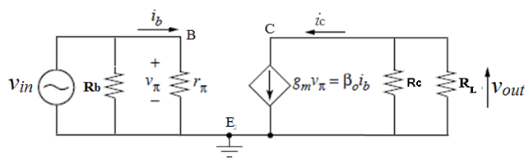
Here
If Vin =A.sin(ωt) then
Small signal model

Slide 7
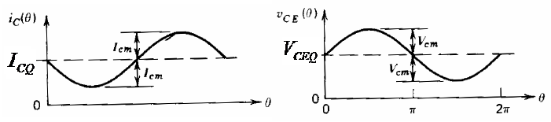
By superposition , total collector current is :
DC
AC
By superposition , total collector voltage is :
DC
AC
DC component is created by the DC biasing circuit.
AC component is created by small signal v_{C}
The total current at collector : i_{C_Total}
The total voltage at collector : v_{CE_Total}

Slide 8
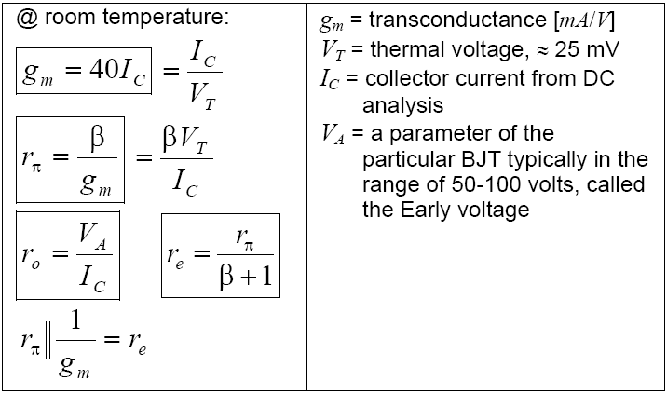
EQUATIONS FOR AC ANALYSIS
8

Slide 9
Question 1
V_{CC} = 10 V, R₁ = 5KΩ, R₂ = 5KΩ, R_{E} = 4.3KΩ, R_{C} = 0Ω and β = 100.
Compute:
a. I_{CQ}
b. V_{CEQ}
c. g_{m}
d. r_{π}
e. r_{e}
You submit your solution not later than March 13, 2020.
You can send your solution with any format to Mr. Huy through his email nbdhuy@hcmiu.edu.vn

